Slide 1
Government actions to fight against
non-communicable diseases in Sri Lanka
National policy and strategic framework for prevent and control non-communicable diseases.
Actions for reduce harmful use of alcohol.
Actions for reduce tobacco use.
Actions for prevent heart attacks and strokes.
Actions for improve access to medicine and technologies.
Hewavitharana D.L. IT21189630 Batch 10.2 G2

Slide 2
National policy and strategic framework for
prevent & control NCD
In 2010, Ministry of Health published the national policy and framework to prevent & control non-communicable diseases in Sri Lanka.
To achieve the main intention, they have focused on three approaches. Those are,
Awareness
They have mentioned a brief description of what are the most common NCDs in Sri Lanka and what are the causes for that.
Counselling
To help the citizen who addicted to the unhealthy habits which leads to NCDs to stop those habits.
Create environments that encourage healthy lifestyle.
Actions to empower the society for promote healthy lifestyle for prevent & control NCDs
Hewavitharana D.L. IT21189630 Batch 10.2 G2

Slide 3
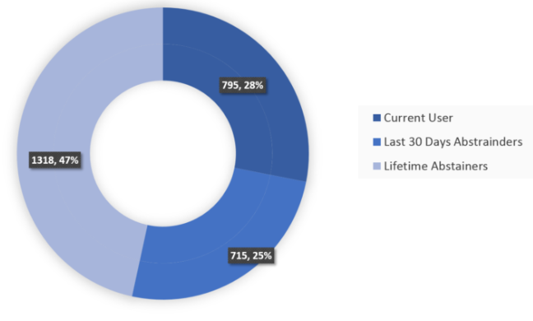
Actions for reduce harmful use of alcohol
Harmful use of alcohol cause many non-communicable diseases like, cirrhosis of the liver, pancreatitis , cancers.
There are some policies and interventions taken by the government to reduce harmful use of alcohol.
Marketing policy
Pricing trade and investment policies
Drink driving policies and countermeasures
Community action
Availability and accessibility of alcohol products
Graph: Status of Alcohol use among males
Source: ADIC Trend Survey 2019
(Alcohol & Drug Information Centre)
Hewavitharana D.L. IT21189630 Batch 10.2 G1

Slide 4
Actions for reduce tobacco use
Tobacco is considered as the most responsible reason for 1 in every 10 adult deaths in Sri Lanka.
There are several tobacco control initiatives taken by Sri Lankan government.
Among those initiatives the “NATA Act” is very special.
National Authority on Tobacco and Alcohol also known as “NATA” is the authority which is deployed to reduce the tobacco and alcohol.
NATA act prohibits,
Sell tobacco products to person below 21 years of age.
Free distribution , promotion or advertisements related to tobacco products.
Installation of vending machines for tobacco products.
Smoking in public places.
Hewavitharana D.L. IT21189630 Batch 10.2 G2

Slide 5
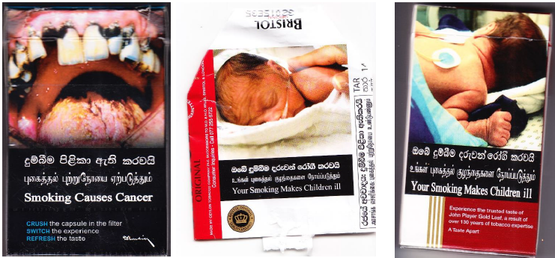
Actions for reduce tobacco use cont.
Also, we can list some other important initiatives as below,
Packaging and labeling restrictions
On 1st of June 2015 Sri Lanka recommended to add pictorial health warnings covering 80% of the top surface area of both front and back covers of tobacco packets.
Price and Tax measures.
According to a proposal of NATA, cabinet approval was obtained for a 74% increase in tax on cigarettes in 2016.
Pictorial warnings
Hewavitharana D.L. IT21189630 Batch 10.2 G2

Slide 6
Actions for prevent heart attacks & strokes
Hewavitharana D.L. IT21189630 Batch 10.2 G2

Slide 7
Reference
Sri Lanka alcohol fact sheet 2020 by ADIC
https://adicsrilanka.org/alcohol-fact-sheet-2020/
“Prevention and Control of Noncommunicable Diseases” Book –
http://www.health.gov.lk/moh_final/english/public/elfinder/files/Downloade/NCDbook2018.pdf
Tobacco Tactics by University of Bath –
https://tobaccotactics.org/wiki/sri-lanka-country-profile/
Hewavitharana D.L. IT21189630 Batch 10.2 G2

